Slide 1
Software Engineering, UNIT 2
Dr. Ram Kumar, SoCS, UPES

Slide 2
What is Requirements Engineering?
A systematic and strict approach to the definition, creation and verification of requirements for a software system is known as requirements engineering. In order to guarantee the effective creation of a software product, the requirements engineering process entails a number of tasks that help in understanding, recording and managing the demands of stakeholders.
The requirements engineering process is an iterative process that involves several steps, including:

Slide 3
Requirements Elicitation
This is the process of gathering information about the needs and expectations of stakeholders for the software system. This step involves interviews, surveys, focus groups, and other techniques to gather information from stakeholders.

Slide 4
Requirements Analysis
This step involves analyzing the information gathered in the requirements elicitation step to identify the high-level goals and objectives of the software system. It also involves identifying any constraints or limitations that may affect the development of the software system.

Slide 5
Requirements Specification
This step involves documenting the requirements identified in the analysis step in a clear, consistent, and unambiguous manner. This step also involves prioritizing and grouping the requirements into manageable chunks.

Slide 6
Requirements Validation
This step involves checking that the requirements are complete, consistent, and accurate. It also involves checking that the requirements are testable and that they meet the needs and expectations of stakeholders.

Slide 7
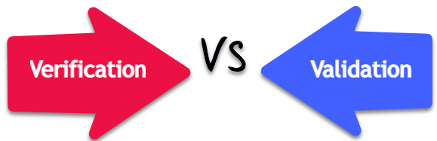

Slide 8
Verification and validation are not the same thing, although they are often confused. Boehm succinctly expressed the difference as
Verification: Are we building the product right?
Validation: Are we building the right product?
In simple terms, software verification is: Assuming we should build X, does our software achieve its goals without any bugs or gaps?
On the other hand, software validation is: "Was X what we should have built? Does X meet the high-level requirements?"

Slide 9
Requirements Management
This step involves managing the requirements throughout the software development life cycle, including tracking and controlling changes, and ensuring that the requirements are still valid and relevant.

Slide 10
Involved in Requirement Engineering
observation report
Questionnaire ( survey , poll )
Use cases
User stories
Requirement workshop
Mind mapping
Role playing
Prototyping

Slide 11
Thank You

Slide 12
Types of requirement
User requirements
Statements in natural language plus diagrams of the services the system provides and its operational constraints. Written for customers
System requirements
A structured document setting out detailed descriptions of the system services. Written as a contract between client and contractor
Software specification
A detailed software description which can serve as a basis for a design or implementation. Written for developers

Slide 13
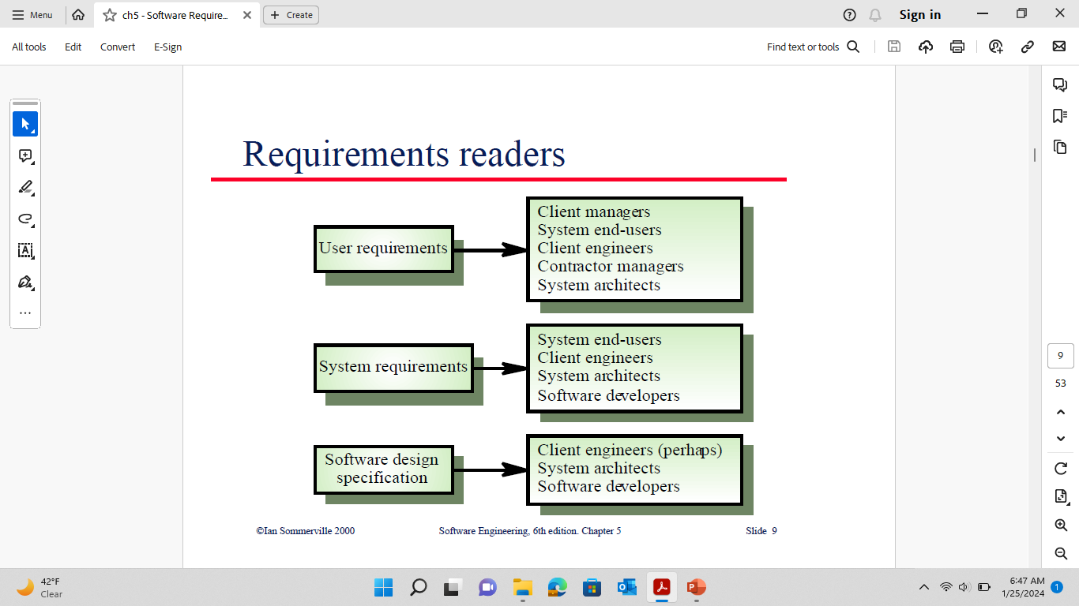

Slide 14
The requirements document
The requirements document is the official statement of what is required of the system developers
Should include both a definition and a specification of requirements
It is NOT a design document. As far as possible, it should set of WHAT the system should do rather than HOW it should do it

Slide 15
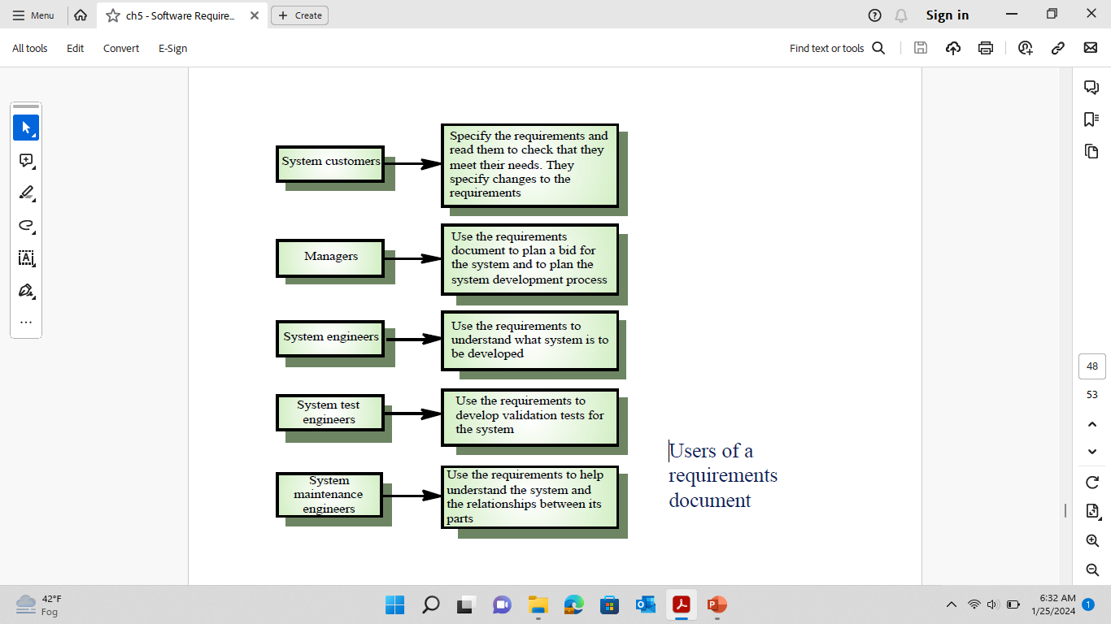

Slide 16
Requirements document need
Specify external system behaviour
Specify implementation constraints
Easy to change
Serve as reference tool for maintenance
Record forethought about the life cycle of the system i.e. predict changes
Characterise responses to unexpected events

Slide 17
IEEE requirements standard
This is a generic structure that must be instantiated for specific systems
Introduction
General description
Specific requirements
Appendices
Index

Slide 18
Requirements document structure
Introduction
Glossary
User requirements definition
System architecture
System requirements specification
System models
System evolution
Appendices
Index

Slide 19
Key points
Requirements set out what the system should do and define constraints on its operation and implementation
Functional requirements set out services the system should provide
Non-functional requirements constrain the system being developed or the development process
User requirements are high-level statements of what the system should do

Slide 20
Key Points Continue…
User requirements should be written in natural language, tables and diagrams
System requirements are intended to communicate the functions that the system should provide
System requirements may be written in structured natural language, a PDL or in a formal language
A software requirements document is an agreed statement of the system requirements

Slide 21
Software Requirement Specifications
Software Requirements Specifications (SRS) (also called a requirements document) lays a foundation for software engineering activities and is constructing when entire requirements are elicited and analyzed.
SRS is a formal report, which acts as a representation of software that enables the customers to review whether it (SRS) is according to their requirements. Also, it comprises user requirements for a system as well as detailed specifications of the system requirements.
The SRS is a specification for a specific software product, program, or set of applications that perform particular functions in a specific environment. It serves several goals depending on who is writing it.
First, the SRS could be written by the client of a system.
Second, the SRS could be written by a developer of the system.
The two methods create entirely various situations and establish different purposes for the document altogether.
The first case, SRS, is used to define the needs and expectation of the users.
The second case, SRS, is written for various purposes and serves as a contract document between customer and developer.

Slide 22
Characteristics of good SRS

Slide 23
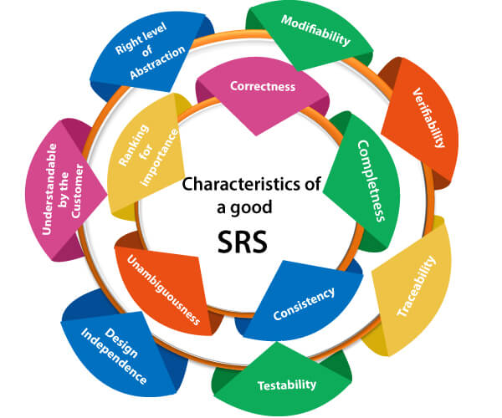

Slide 24
Following are the features of a good SRS document:
1. Correctness: User review is used to provide the accuracy of requirements stated in the SRS. SRS is said to be perfect if it covers all the needs that are truly expected from the system.
2. Completeness: The SRS is complete if, and only if, it includes the following elements:
All essential requirements, whether relating to functionality, performance, design, constraints, attributes, or external interfaces.
Definition of their responses of the software to all realizable classes of input data in all available categories of situations.
Full labels and references to all figures, tables, and diagrams in the SRS and definitions of all terms and units of measure.

Slide 25
3. Consistency: The SRS is consistent if, and only if, no subset of individual requirements described in its conflict. There are three types of possible conflict in the SRS:
A. The specified characteristics of real-world objects may conflicts. For example,
(a) The format of an output report may be described in one requirement as tabular but in another as textual.
(b) One condition may state that all lights shall be green while another states that all lights shall be blue.
B. There may be a reasonable or temporal conflict between the two specified actions. For example,
(a) One requirement may determine that the program will add two inputs, and another may determine that the program will multiply them.
(b) One condition may state that "A" must always follow "B," while other requires that "A and B" co-occurs.
C. Two or more requirements may define the same real-world object but use different terms for that object. For example, a program's request for user input may be called a "prompt" in one requirement's and a "cue" in another. The use of standard terminology and descriptions promotes consistency.

Slide 26
4. Unambiguousness: SRS is unambiguous when every fixed requirement has only one interpretation. This suggests that each element is uniquely interpreted. In case there is a method used with multiple definitions, the requirements report should determine the implications in the SRS so that it is clear and simple to understand.
5. Ranking for importance and stability: The SRS is ranked for importance and stability if each requirement in it has an identifier to indicate either the significance or stability of that particular requirement.
Typically, all requirements are not equally important. Some prerequisites may be essential, especially for life-critical applications, while others may be desirable. Each element should be identified to make these differences clear and explicit. Another way to rank requirements is to distinguish classes of items as essential, conditional, and optional.

Slide 27
6. Modifiability: SRS should be made as modifiable as likely and should be capable of quickly obtain changes to the system to some extent. Modifications should be perfectly indexed and cross-referenced.
7. Verifiability: SRS is correct when the specified requirements can be verified with a cost-effective system to check whether the final software meets those requirements. The requirements are verified with the help of reviews.

Slide 28
8. Traceability: The SRS is traceable if the origin of each of the requirements is clear and if it facilitates the referencing of each condition in future development or enhancement documentation.
There are two types of Traceability:
A. Backward Traceability: This depends upon each requirement explicitly referencing its source in earlier documents.
B. Forward Traceability: This depends upon each element in the SRS having a unique name or reference number.
The forward traceability of the SRS is especially crucial when the software product enters the operation and maintenance phase. As code and design document is modified, it is necessary to be able to ascertain the complete set of requirements that may be concerned by those modifications.

Slide 29
9. Design Independence: There should be an option to select from multiple design alternatives for the final system. More specifically, the SRS should not contain any implementation details.
10. Testability: An SRS should be written in such a method that it is simple to generate test cases and test plans from the report.
11. Understandable by the customer: An end user may be an expert in his/her explicit domain but might not be trained in computer science. Hence, the purpose of formal notations and symbols should be avoided too as much extent as possible. The language should be kept simple and clear.
12. The right level of abstraction: If the SRS is written for the requirements stage, the details should be explained explicitly. Whereas,for a feasibility study, fewer analysis can be used. Hence, the level of abstraction modifies according to the objective of the SRS.

Slide 30
Properties of a good SRS document
The essential properties of a good SRS document are the following:
Concise: The SRS report should be concise and at the same time, unambiguous, consistent, and complete. Verbose and irrelevant descriptions decrease readability and also increase error possibilities.
Structured: It should be well-structured. A well-structured document is simple to understand and modify. In practice, the SRS document undergoes several revisions to cope up with the user requirements. Often, user requirements evolve over a period of time. Therefore, to make the modifications to the SRS document easy, it is vital to make the report well-structured.

Slide 31
Black-box view: It should only define what the system should do and refrain from stating how to do these. This means that the SRS document should define the external behavior of the system and not discuss the implementation issues. The SRS report should view the system to be developed as a black box and should define the externally visible behavior of the system. For this reason, the SRS report is also known as the black-box specification of a system.
Conceptual integrity: It should show conceptual integrity so that the reader can merely understand it. Response to undesired events: It should characterize acceptable responses to unwanted events. These are called system response to exceptional conditions.

Slide 32
Verifiable: All requirements of the system, as documented in the SRS document, should be correct. This means that it should be possible to decide whether or not requirements have been met in an implementation.

Slide 33
Thank You

